Slide 1
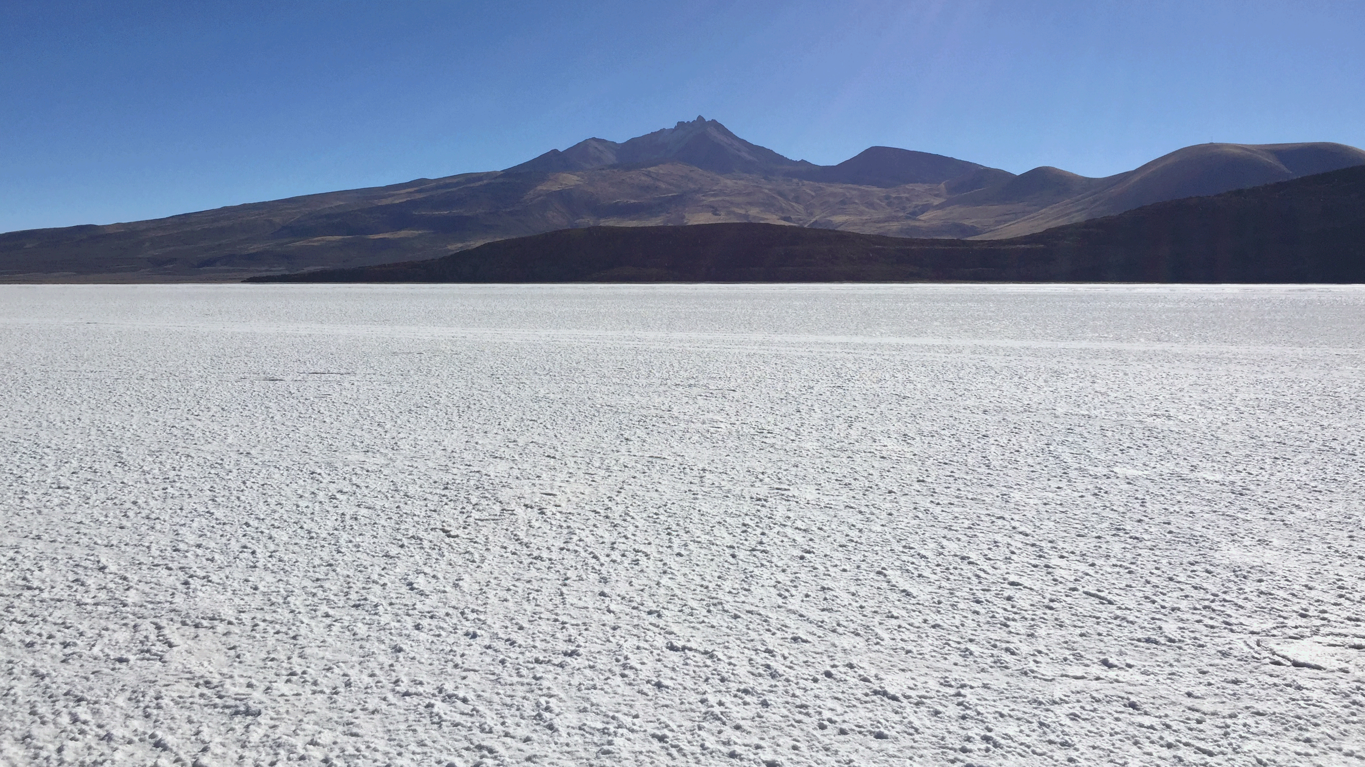

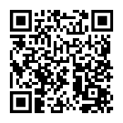
IEEEXtreme Programming Competition
at the
University of New Brunswick
https://ieeextreme.org/ b.petersen@ieee.org
Register Questions

